Slide 1
Warwalking
Team Copy Pasta Dhal Wayne Lorenzo
Kristin Kogasaka
Brandon Chun

Slide 2
What is Warwalking?
Testing wireless networks
Locating Vulnerable Wireless access points

Slide 3
WiGLE WiFi
Open source alternative to netstumbler on mobile
Gives information on SSID, MAC address, encryption type

Slide 4
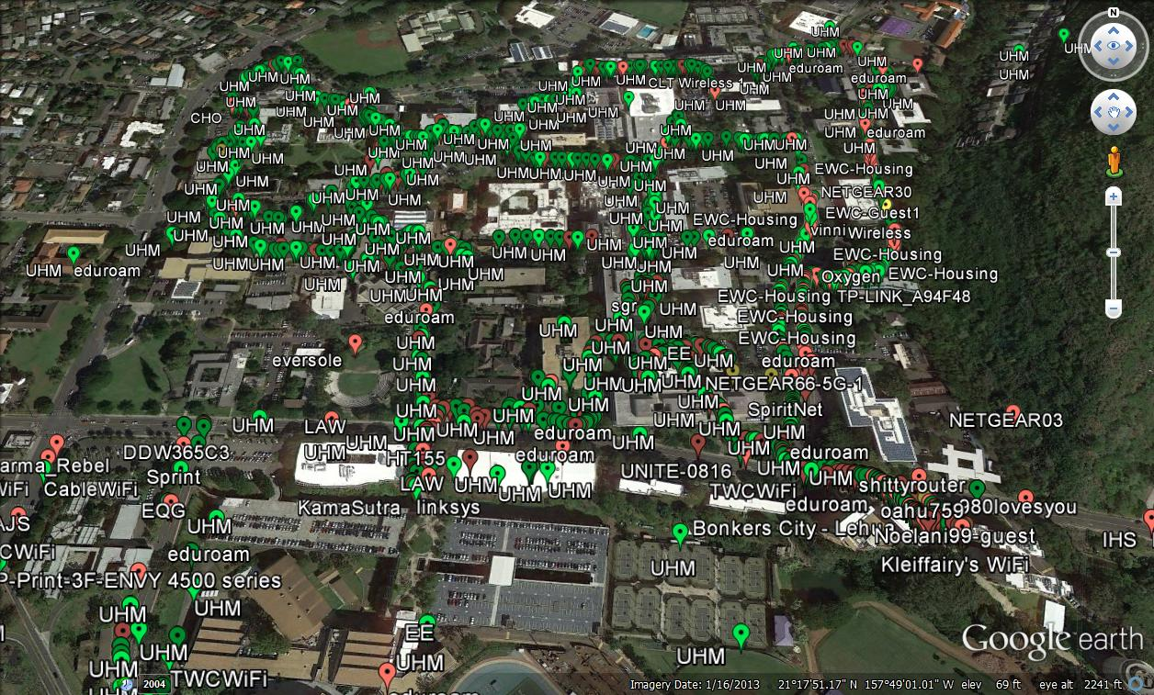
Map of Experiment

Slide 5
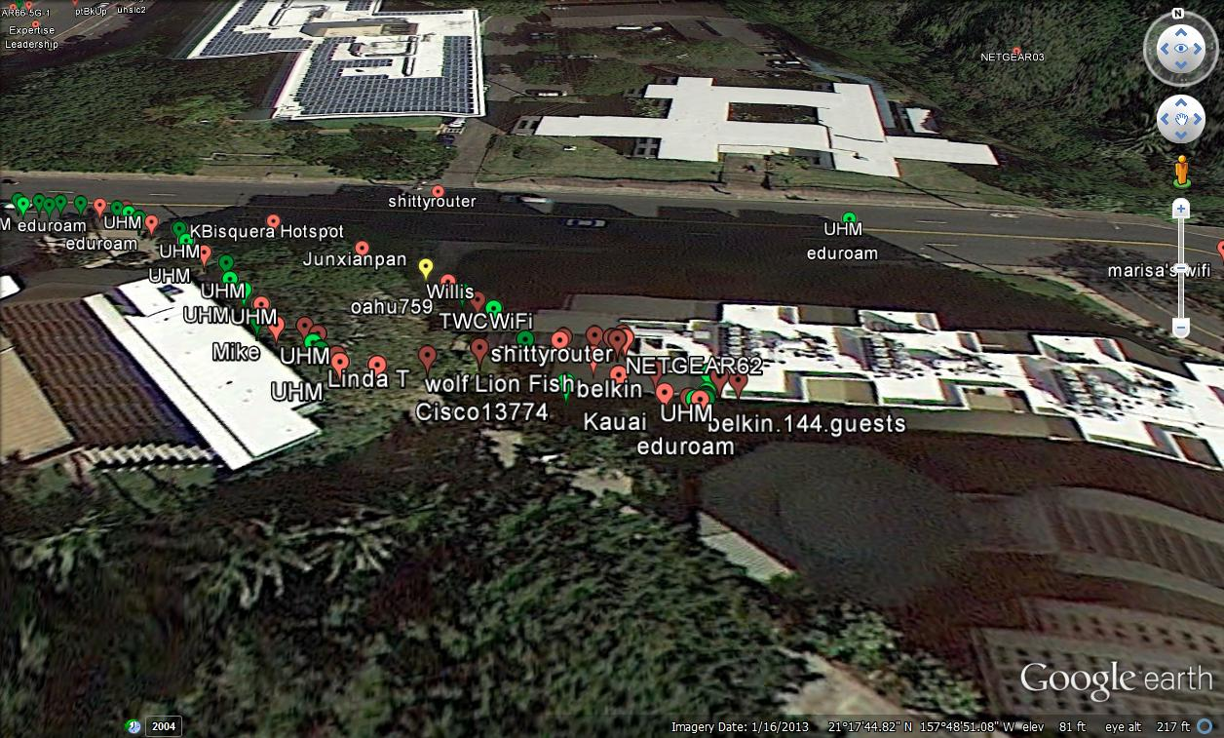
Student Housing Area

Slide 6
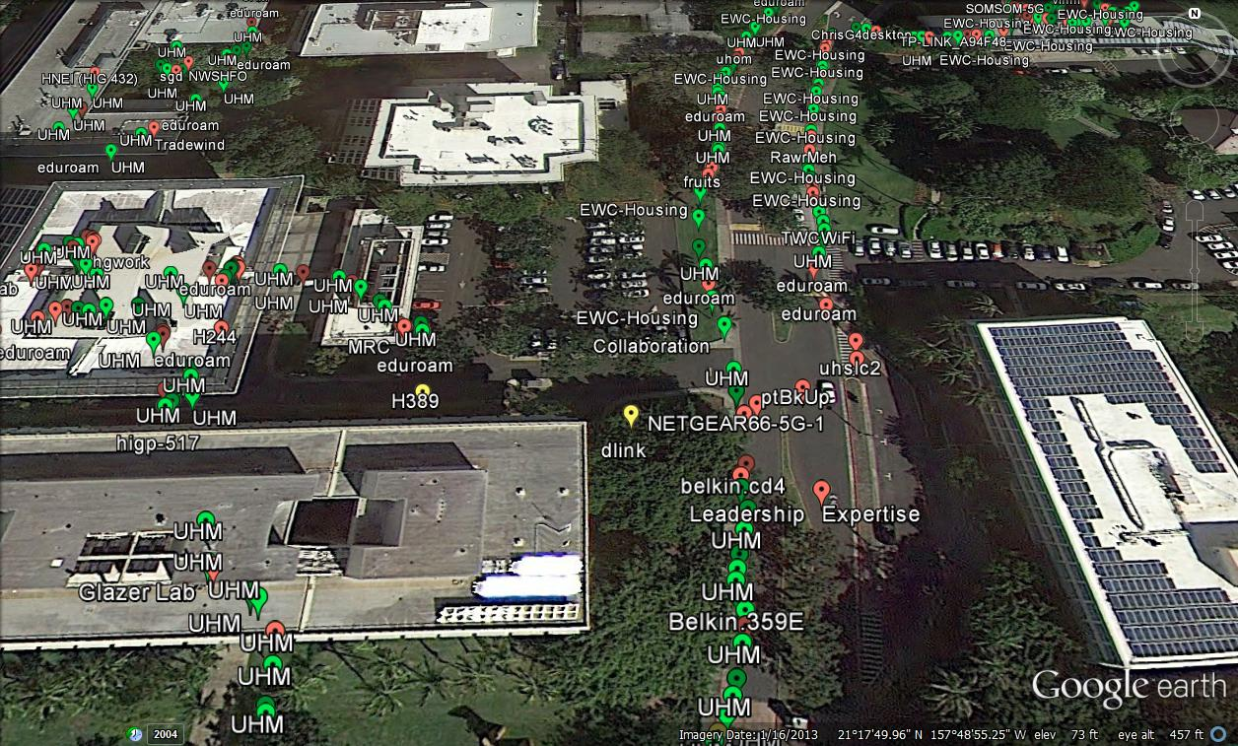
Holmes Hall and East-West Road

Slide 7
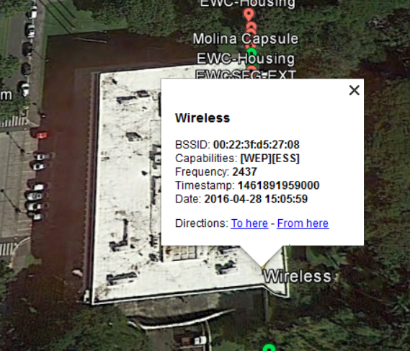
Jefferson Hall

Slide 8
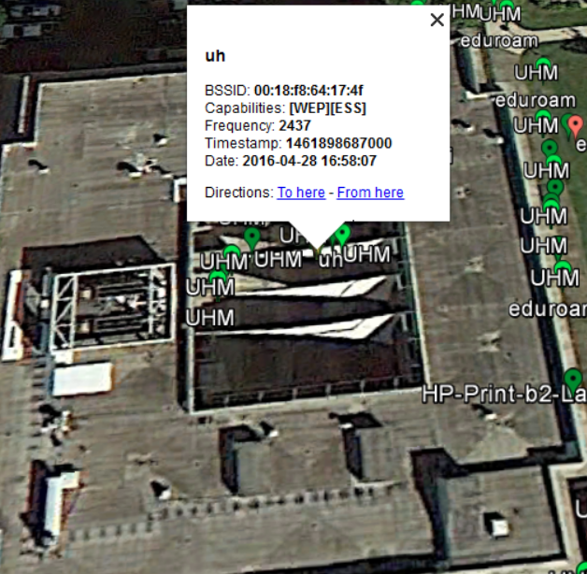
Architectural Building

Slide 9
Securing WiFi
Don’t implement WEP use WPA/WPA2
Inform on wireless vulnerabilities
Secure passwords

Slide 10
The End

